Slide 1
Functions, loops, conditionals
Week 2, Computational Genomics
Notes:
Objective of this lesson: Students should be able to…
Recognize the code structure of a function: input arguments, return value, and body statements.
Clarify the difference between global and local variables in the context of variable scoping.
Recognize that a function is stored like a variable in the global environment, and that it needs to be defined before it is called.
Recall how an iteration/for loop works step-by-step as the iterating variable changes.
Compare the coding efficiency of an iteration on each element of a vector to expression overload on a vector.
Define what expression overload is, why it is useful and can be confusing.
Recognize the code structure of a conditional if-else block.
Given various conditions, determine which if-else block will run.
Design a function with inputs, outputs, and the steps it take to get to the output, using mostly vectors, dataframes, and elementary data types. They should then be able to implement it in code.
Check whether a function works as it is designed to do.

Slide 2
Recap/what’s ahead
What has been discussed and practiced:
How to write expressions on data types and data objects using functions and operations.
Let’s go deeper in the machinery:
How does one write a function?
How does one automate repetitive tasks?
How does one deal with complex logical scenarios?
Notes:
Before we look at more functions, data types, and operators that make encoding and organizing biology effective -- we will be using more fancy functions and data objects to make our lives easier -- we need to slow down and understand a few technical machinery, because we will misuse some of these tools, and when we do, we need to understand how they work: how do people create new functions and write code that is efficient and complex.
Computers = powerful + stupid -- we need to speak the language, and also troubleshoot when it does something we don’t intend.

Slide 3
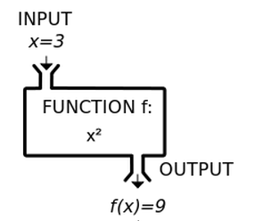

Writing functions

Slide 4
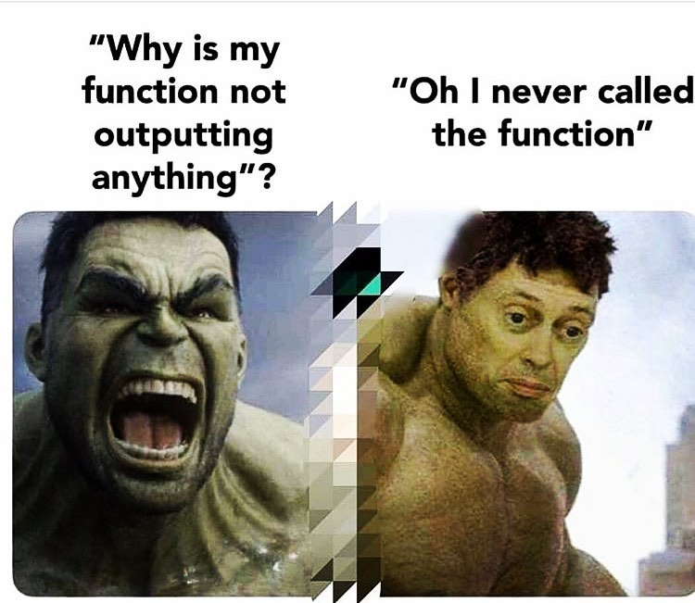
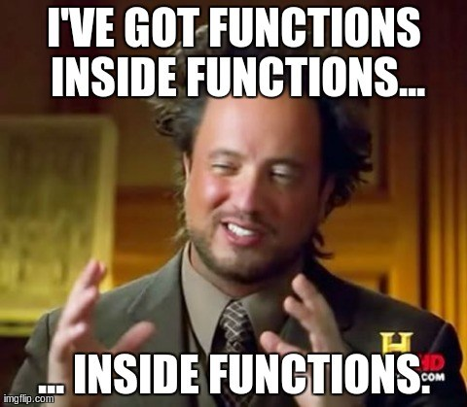
Writing functions

Slide 5
Writing functions
Function definition consist of a function statement that has a comma-separated list of named function arguments, and a return expression. The function definition is assigned to a variable in the global environment.
In order to use the function, one defines or import it, then one calls it.
addFunction = function(argument1, argument2) {
result = argument1 + argument2
return(result)
}
z = addFunction(3, 4)
Notes:
A function has a name, arguments, and a return type. How do we write a function and give instructions in the black box?
When the function is called, the variables for the arguments are reassigned to function arguments. This helps with modularity.
Notice that the order of code run is different -- not all code runs from top to bottom.

Slide 6
Composing functions
{ } represents variable scoping: within each { }, if variables are defined, they are stored in a local environment, and is only accessible within { }. All function arguments are stored in the local environment. The overall environment is called the global environment and can be also accessed within { }.
addFunction = function(argument1, argument2) {
result = argument1 + argument2
return(result)
}
z = addFunction(3, 4)
Notes:
The reason of having some of this “privacy” in the local environment is to make functions modular - they are independent little tools that should not interact with the rest of the global environment.
Imagine someone writing a tool that they want to give someone else to use, but the tool depends on your environment, vice versa.

Slide 7
Console Environment
> addFunction = function(argument1, argument2) { ... }
addFunction = function(...)
Notes:
Mutable vs. not mutable - modifying nChrs does not change the value of totalChrs.

Slide 8
Console Environment
> addFunction = function(argument1, argument2) { ... }
> z = myFunction(3, 4)
addFunction = function(...)

Slide 9
Console Environment
Local Environment
> addFunction = function(argument1, argument2) { ... }
> z = addFunction(3, 4)
addFunction = function(...)
result = argument1 + argument2
argument1 = 3
argument2 = 4
result = 3 + 4

Slide 10
Console Environment
Local Environment
> addFunction = function(argument1, argument2) { ... }
> z = addFunction(x, y)
addFunction = function(...)
result = argument1 + argument2
return(result)
argument1 = 3
argument2 = 4
result = 7

Slide 11
Console Environment
> addFunction = function(argument1, argument2) { ... }
> z = addFunction(x, y)
addFunction = function(...)
z = 7
Notes:
Mutable vs. not mutable - modifying nChrs does not change the value of totalChrs.
# as comment

Slide 12
Composing functions
Scoping makes functions modular: consider the following alternative:
x = 3
y = 4
addFunction = function(argument1, argument2) {
result = x + y
return(result)
}
z = addFunction(x, y)
w = addFunction(10, -5)
Why won’t this do what we want????
Notes:
The reason of having some of this “privacy” in the local environment is to make functions modular - they are independent little tools that should not interact with the rest of the global environment.
Imagine someone writing a tool that they want to give someone else to use, but the tool depends on your environment, vice versa.

Slide 13
Console Environment
> x = 3
> y = 4
> addFunction = function(argument1, argument2) { ... }
> w = addFunction(10, -5)
x = 3
y = 4
addFunction = function(...)
Notes:
Mutable vs. not mutable - modifying nChrs does not change the value of totalChrs.
# as comment

Slide 14
Console Environment
Local Environment
> w = addFunction(10, -5)
x = 3
y = 4
addFunction = function(...)
result = x + y
argument1 = 10
argument2 = -5
result = 3 + 4
Notes:
Mutable vs. not mutable - modifying nChrs does not change the value of totalChrs.
# as comment

Slide 15
Console Environment
Local Environment
> w = addFunction(10, -5)
x = 3
y = 4
addFunction = function(...)
result = x + y
return(result)
argument1 = 10
argument2 = -5
result = 3 + 4
Notes:
Mutable vs. not mutable - modifying nChrs does not change the value of totalChrs.
# as comment

Slide 16
Console Environment
> z = addFunction(10, -5)
x = 3
y = 4
addFunction = function(...)
z = 7
Notes:
Mutable vs. not mutable - modifying nChrs does not change the value of totalChrs.
# as comment

Slide 17
Composing a function
From the first homework, you looked at chr. ploidy in the human genome.
Create your own function: somaticToGermline, which takes the ploidy vector and halves it, as if somatic cells undergo meiosis.
Input argument: a numeric vector of chromosome copies.
Output: a numeric vector of chromosome copies, halved.
Try it out, and test it to show that it works.
Notes:
What do you anticipate to get if you use an input of diploid human chromosome?
Need to familiar with vector operations.
somaticToGermline = function(chrNum) {
return(chrNum / 2)
}
chrNum = rep(2, 23)
somaticToGermline(chrNum)
What happens if we have an odd number of chromosome? What can be done for this function to encode biology more realistically?

Slide 18
Composing a function
From the first homework, you looked at chr. ploidy in the human genome.
Create your own function: numNonDiploid, which takes the ploidy vector and returns the number of chromosomes that are not diploid (!= 2).
Input argument: a numeric vector of ploidy.
Output: a numeric value.
Try it out, and test it to show that it works.
Notes:
numNonDiploid = function(myCN) {
nonDiploids = myCN[myCN != 2]
return(length(nonDiploids))
}

Slide 19
numNonDiploid = function(myNumChrs) {
nonDiploids = myNumChrs[myNumChrs != 2]
return(length(nonDiploids))
}
numChrs = rep(2, 23)
nonDiploids_numChrs = numNonDiploid(numChrs)
Notes:
Example of length 0 being returned: testing extreme values to understand the boundary of a function.
30min?

Slide 20
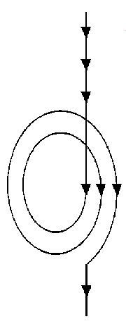

Slide 21
Looping
for (i in my_vector) {
...
}
Within for-loop iteration, a chunk of code within a local scope is repeated many times. Within each iteration, a local looping variable re-assigns its value to elements from a looping vector.

Slide 22
Console Environment
Local Environment
> sum = 0
> for(i in 1:10) {
sum = sum + i
}
sum = 0
i = 1

Slide 23
Console Environment
Local Environment
> sum = 0
> for(i in 1:10) {
sum = sum + i
}
sum = 1
i = 1

Slide 24
Console Environment
Local Environment
> sum = 0
> for(i in 1:10) {
sum = sum + i
}
sum = 3
i = 2

Slide 25
Console Environment
Local Environment
> sum = 0
> for(i in 1:10) {
sum = sum + i
}
sum = 6
i = 3

Slide 26
Console Environment
> sum = 0
> for(i in 1:10) {
sum = sum + i
}
sum = 55

Slide 27
Looping
numChrs = rep(2, 23)
for(i in 1:length(numChrs)) {
numChrs[i] = numChrs[i] / 2
}
Compare it to:
numChrs = numChrs / 2
Notes:
This is an example about looping -- but also about interpretations of operations on data types and data objects.
You took it granted for Datacamp and your first homework set!
It makes sense intuitively, but we need to be careful how we interpret it!
For example, what is
CN*CN?
Could be element-to-element vector product, or maybe a dot product? Or a cross product?

Slide 28
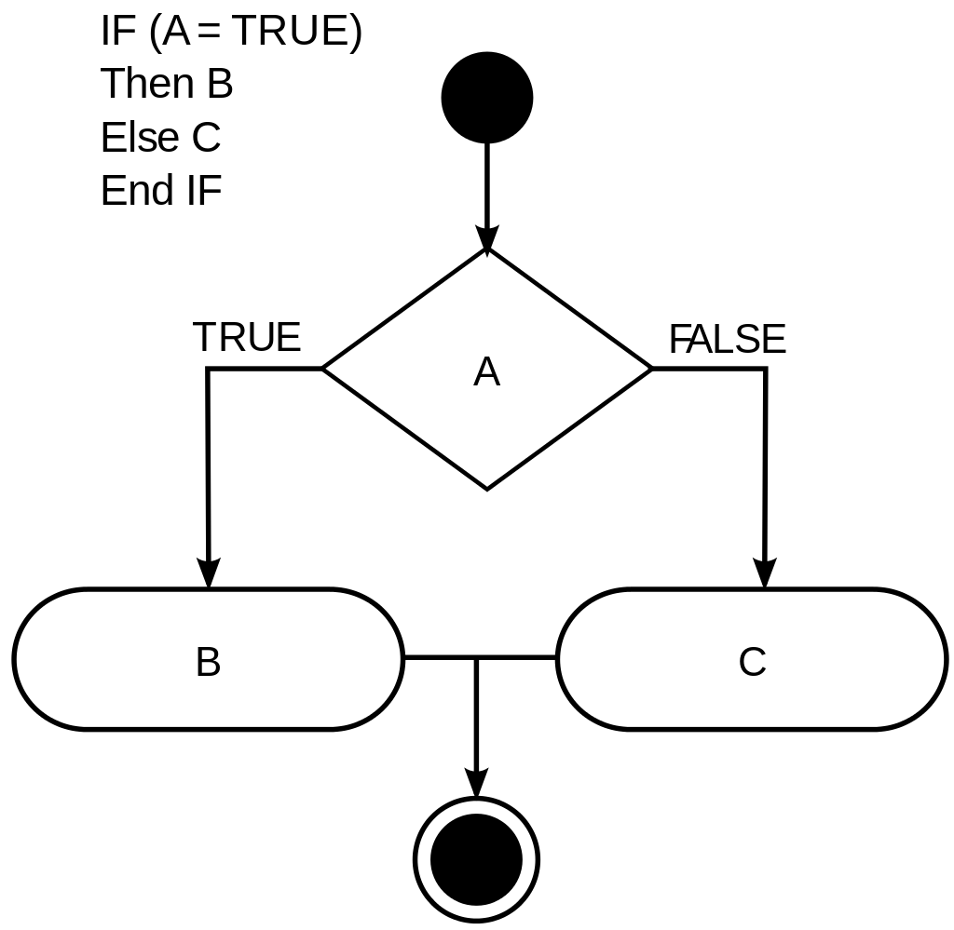
Conditionals
Notes:
If this comparison operation is true, then….

Slide 29

Conditionals
Notes:
If this comparison operation is true, then….

Slide 30
Conditionals
if(boolean_value) {
...
}
if(boolean_value_1) {
…
}else if(boolean_value_2) {
…
}else {
...
}
In a conditional statement, if the logical value tested (usually by comparison operation) is evaluated as True, then the body code within the local environment will run. If the logical value tested is evaluated as False, then the body code within the local environment will not run. Longer conditional statements can be built from else if and else conditional statements.
Notes:
Forks in the road
This comparison operation needs to return a single logical value, not a vector of logicals.

Slide 31
Conditionals
if(length(numChrs) == 23) {
print(“Human chromosome detected.”)
else{
print(“Non-human chromosome detected.”)
}

Slide 32
Let’s make one together!
somaticToGermline is a function that will give us the number of chromosomes someone has divided by 2, but includes the following:
Will reject the input if the number of chromosomes is not 23
Will round our chromosome number to the nearest multiple of 2 if toRound input is TRUE
Otherwise, it will just divide the chromosome number by 2

Slide 33
somaticToGermline = function(myNumChrs, toRound) {
if(length(myNumChrs) != 23) {
stop(“Invalid input!”)
}
if(toRound) {
return(round(myNumChrs / 2))
else {
return(myNumChrs / 2)
}
}
somaticToGermline(numChrs, True)
somaticToGermline(numChrs, False)
Function arguments can be set as optional if one assigns a value in the function definition.

Slide 34
template = c(“A”, “C”, “G”, “T”, “T”, “C”)
coding = rep(NA, length(template))
for(i in 1:length(template)) {
nuc = template[i]
if(nuc == “A”) {
result = “T”
}else if(nuc == “T”) {
result = “A”
}else if(nuc == “C”) {
result = “G”
} else if(nuc == “G”) {
result = “C”
} else {
result = “N”
coding[i] = result
}
Notes:
Iterating on something existing

Slide 35
Function on iris
Write the following function:
Input arguments
A dataframe variable (expecting iris dataset)
A string variable indicating which species to work with - setosa, versicolor, virginica
Output
A dataframe variable
The function should do the following in its body:
Using the input dataframe, double the value of Petal.Width only for the Species indicated in the second input argument.
Return this new dataframe.
Notes:
petal_width_double = function(df, species) {
df$Petal.Width[df$Species == species] = df$Petal.Width[df$Species == species] * 2
return(df)
}
Might need to look at it visually.

Slide 36
Function telephone
Think of a function to implement on the ploidy vector or iris dataframe.
Explain to your partner each argument in the function, what the function task is, and what the return value is. Be clear about the data type!
Implement the function your partner gives you, and test with a few examples to see whether it works.
Share it back to your partner!
Notes:
Try chaining functions together if students write input/outputs that can be fused together.

Slide 37
Additional Resources
Datacamp: Introduction to R. Sections 1, 2, 3: Conditionals, Functions, Loops.
https://learn.datacamp.com/courses/intermediate-r
R Programming for Data Science. Chapters 13 and 14. https://bookdown.org/rdpeng/rprogdatascience/

